Slide 1

NIELIT SUMMER INTERNSHIP MAY-JUNE 2021
Course: Deep Learning using Python
Project done by: (GROUP 12)
1. Abhinav sharma
2. Rashmika b
3. Ravindra kothiyal
4. Soumya upadhyay

Slide 2
Detection of covid -19
Using Deep learning

Slide 3
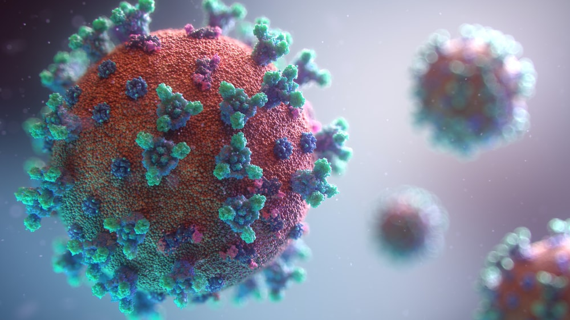
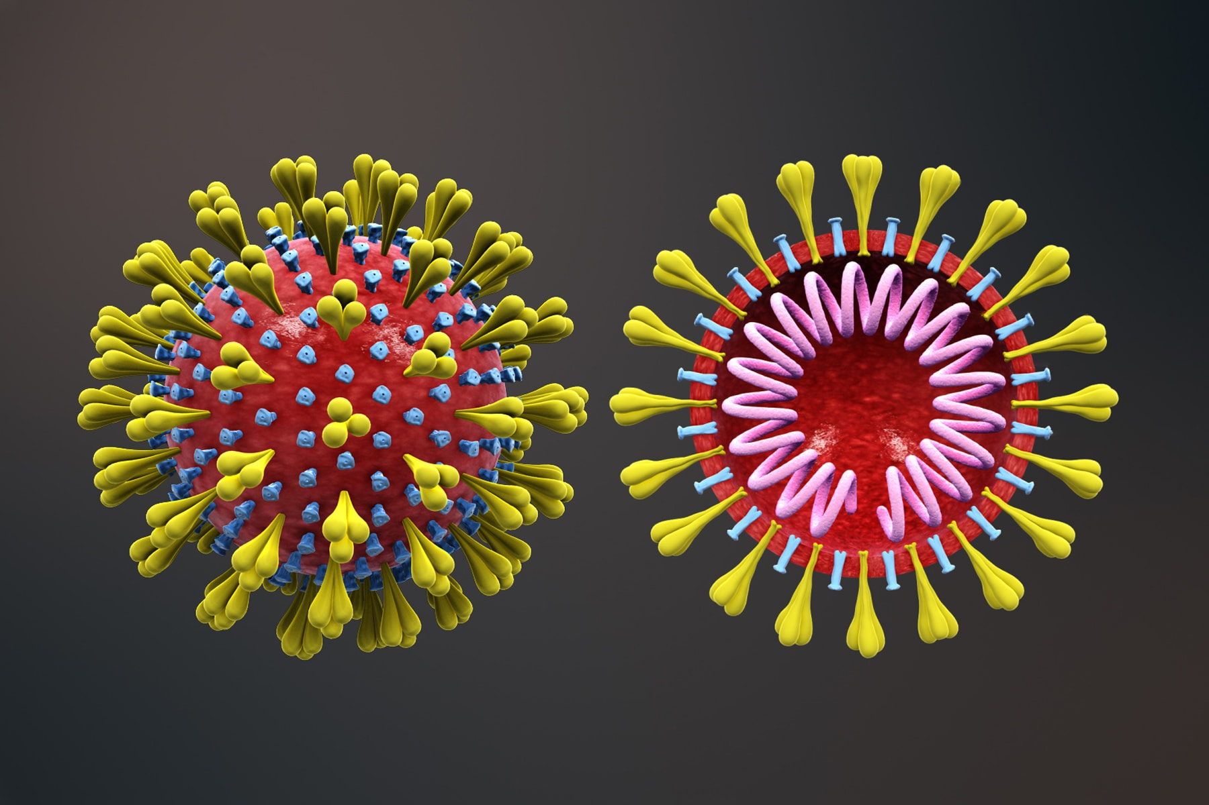
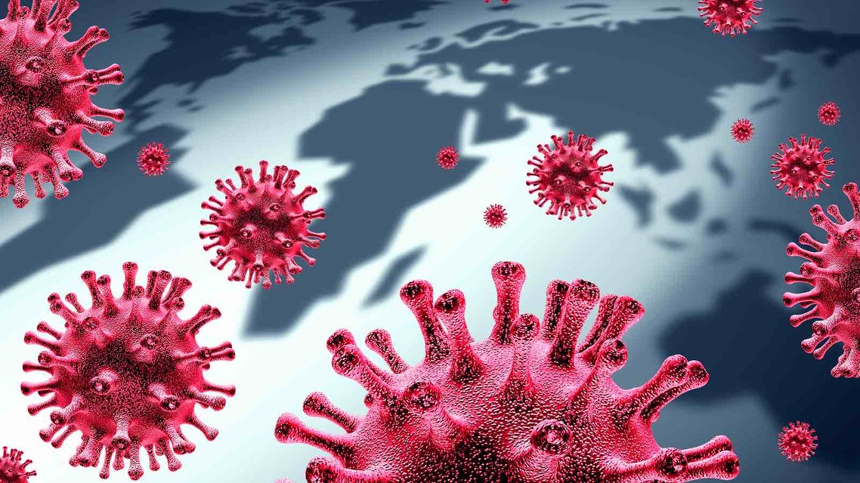
introduction
COVID-19 (coronavirus disease 2019) is an infectious disease caused by severe acute respiratory syndrome coronavirus 2 (SARS-CoV-2. On 11 February 2020, the WHO officially renamed the clinical condition COVID-19. Coronaviruses (CoV) are a large family of viruses that cause illness ranging from the common cold to more severe diseases such as Middle East Respiratory Syndrome (MERS-CoV) and Severe Acute Respiratory Syndrome (SARS-CoV). A novel coronavirus (nCoV) is a new strain that has not been previously identified in humans. It is believed to have zoonotic origins and has close genetic similarity to bat coronaviruses, suggesting it emerged from a bat-borne virus Infected patients show common signs include respiratory symptoms, fever, cough, shortness of breath and breathing difficulties. In more severe cases, the infection can cause pneumonia, severe acute respiratory syndrome, kidney failure, and even death.

Slide 4
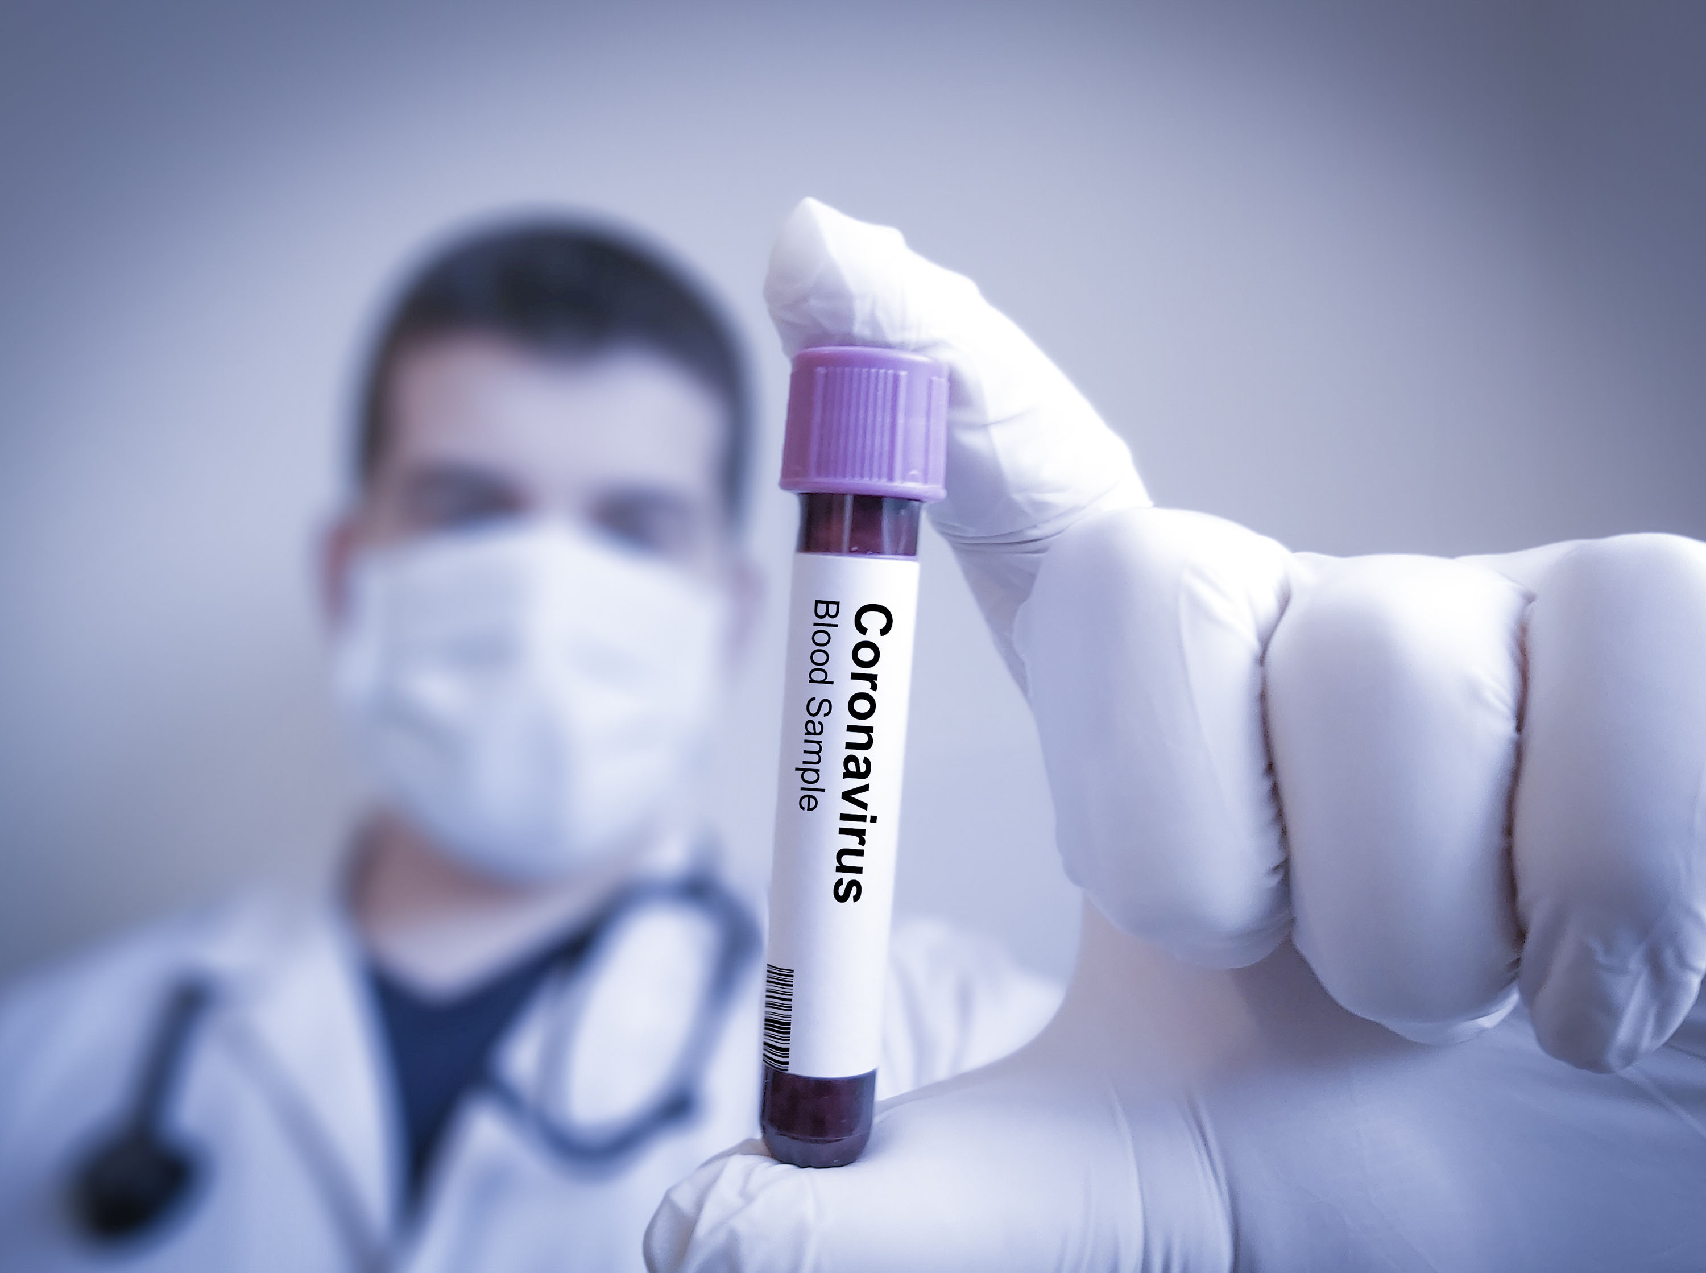
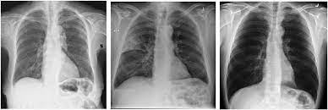
introduction
Patients with respiratory symptoms are advised to stay isolated and undergo further clinical examination RT-PCR (Reverse transcription-polymerase chain reaction). PCR testing is the medical standard to identify COVID-19. However, might take hours to receive results. With the growing number of cases walking into hospitals, alternatively, chest X-ray is used as initial element to review the clinical situation of a patient.
If the X-ray shows any pathological findings, patients are admitted for further diagnosis. If the X-Ray is normal, patients are requested to go home and wait for PCR test results. The X-ray findings that strongly suspect of dealing with COVID-19 infection are the ground glass patterned area, which affects both lungs, in particular the lower lobes, and especially the posterior segments, with a fundamentally peripheral and subpleural distribution in initial stages. Radiology is playing a critical role to identify if a patient can go home to wait for test results (or) get admitted for further observation.

Slide 5
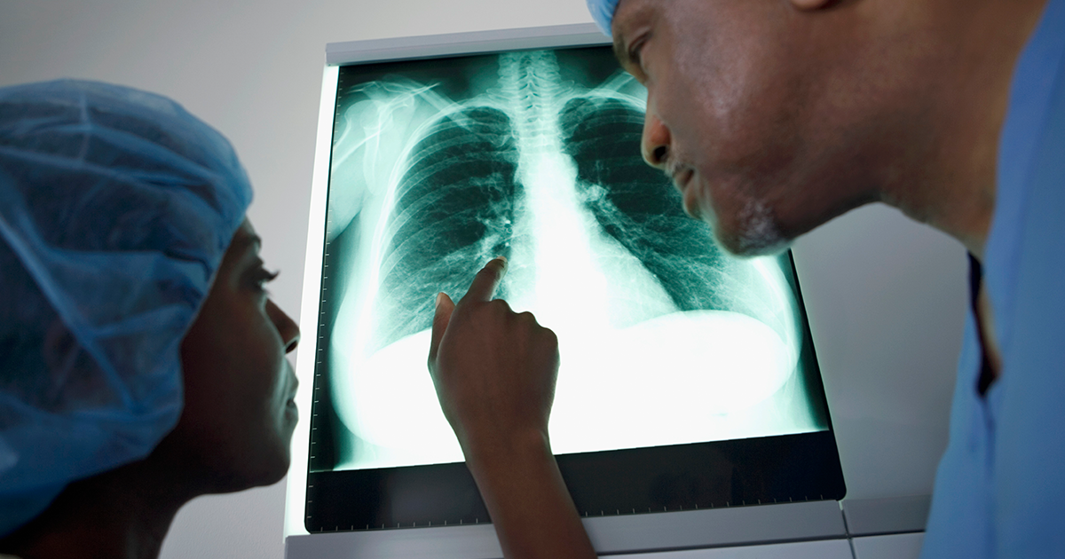
introduction
One of the roadblocks using an X-ray is the availability of the radiology expert to interpret the image. Inspired by the AI (Artificial Intelligence) technology and to assist radiology experts to interpret images in a much faster rate & improved accuracy, proposing a deep learning system to analyze images and detect patterns of COVID-19 in patients. The current COVID-19 pandemic is unprecedented and as we see this is having a profound impact on the World. It is the most serious public health crisis and the most significant geopolitical event of the current generation. The need for continued access to research and learning has never been more important. Especially for India, which is the second highly populated country and is preparing for the worst.
With an AI built CNN network, identifying individuals and assisting in time is a possibility. This in turn will have a greater impact on experts concentrating on severe cases to avoid further spread of the pandemic. With deep learning techniques, X-ray images can be more accurately and efficiently diagnose the disease by understanding the severity and type with the pattern.

Slide 6
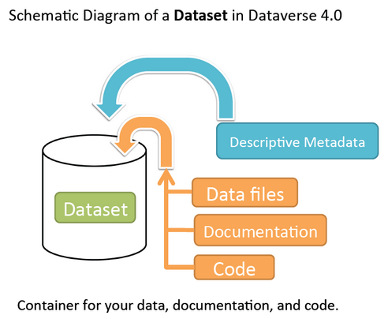
Dataset description
In this study, X-ray images obtained from Kaggle were used for the diagnosis of COVID-19.
A team of researchers from Qatar University, Doha, Qatar, and the University of Dhaka, Bangladesh along with their collaborators from Pakistan and Malaysia in collaboration with medical doctors have created a database of chest X-ray images for COVID-19 positive cases along with Normal and Viral Pneumonia images. This COVID-19, normal, and other lung infection dataset is released in stages. In the first release, the have released 219 COVID-19, 1341 normal, and 1345 viral pneumonia chest X-ray (CXR) images.
In the first update, we have increased the COVID-19 class to 1200 CXR images.
In the 2nd update, they have increased the database to 3616 COVID-19 positive cases along with 10,192 Normal, 6012 Lung Opacity (Non-COVID lung infection), and 1345 Viral Pneumonia images.
This database is constantly updated with images shared by researchers from different regions.

Slide 7
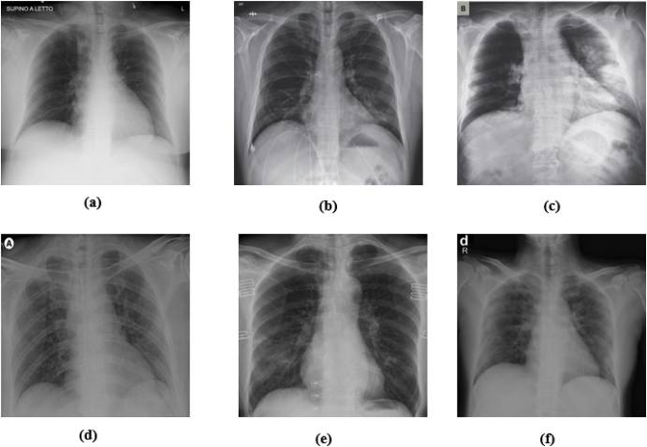
Dataset description
A few COVID-19 cases and findings by dataset:

Slide 8



Coding environment
Programming Language: Python3
Environment: Kaggle kernel
Due to the large size of the dataset, we found it easy to use the Kaggle environment where we could share the codes amongst ourselves and work without even downloading the data.

Slide 9
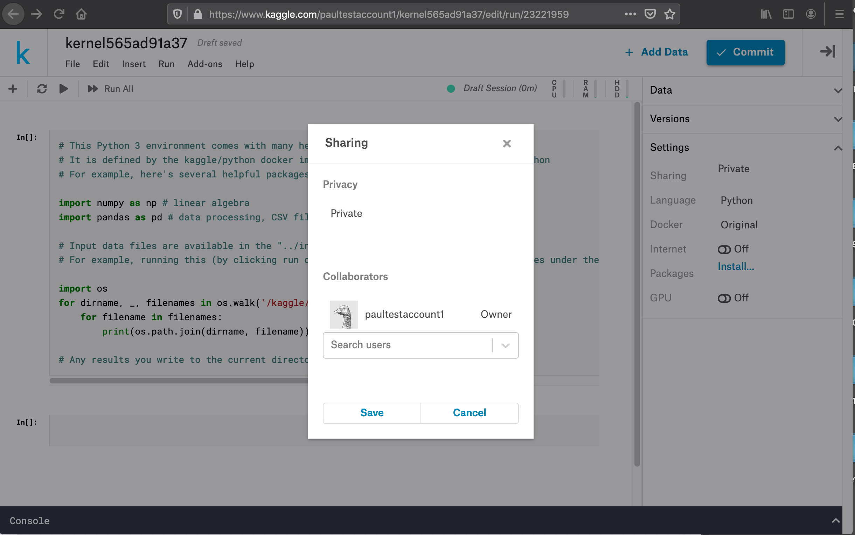
Coding environment

Slide 10
Pre-processing
CNN All the images are in Portable Network Graphics (PNG) file format and the resolution are 299*299 pixels split the datagen into 70% train data and 30% test data. datagen = ImageDataGenerator(rotation_range=20, zoom_range=0.15, width_shift_range=0.2, height_shift_range=0.2, shear_range=0.15, horizontal_flip=True, fill_mode="nearest", rescale=1./255, validation_split=0.3). load the total images to training. load the images to test . In this project, we have 2 classes in dataset – COVID AND NORMAL | VGG-16 Split the datagen into 80% train data and 20% test data. Total images in datasets is14,193 for train and test. In this project, we have 4 classes in dataset - COVID,LUNG-OPACITY,VIRAL PNEUMONIA AND NORMAL.

Slide 11
Basic idea behind the code (CNN)
One of the main parts of Neural Networks is Convolutional neural networks (CNN). They are made up of neurons with learnable weights and biases. Each specific neuron receives numerous inputs and then takes a weighted sum over them, where it passes it through an activation function and responds back with an output.
The architecture of a ConvNet is analogous to that of the connectivity pattern of Neurons in the Human Brain and was inspired by the organization of the Visual Cortex. Individual neurons respond to stimuli only in a restricted region of the visual field known as the Receptive Field. A collection of such fields overlap to cover the entire visual area.

Slide 12
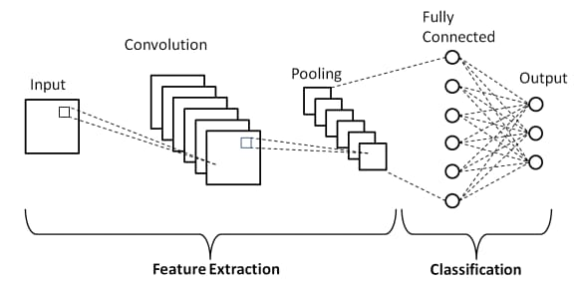
Architecture OF CNN

Slide 13

INSIDE THE ARCHITECTURE OF CNN

Slide 14
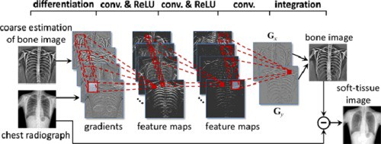
INSIDE THE ARCHITECTURE OF CNN
Feature Extraction is done in this manner between the layers:

Slide 15
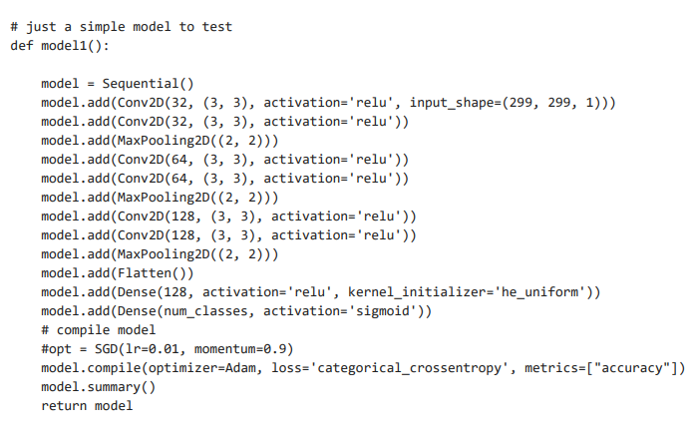
LAYERS IN BASIC CNN PROJECT AND VGG16 MODEL PROJECTs
BASIC CNN MODEL

Slide 16
ARCHITECTURE OF VGG16
VGG16 is a convolution neural net (CNN ) architecture which was used to win ILSVR(Imagenet) competition in 2014. It was based on an analysis of how to increase the depth of such networks. The network utilizes small 3 x 3 filters. Otherwise, the network is characterized by its simplicity: the only other components being pooling layers and a fully connected layer.
The model achieves 92.7% top-5 test accuracy in ImageNet, which is a dataset of over 14 million images belonging to 1000 classes.

Slide 17
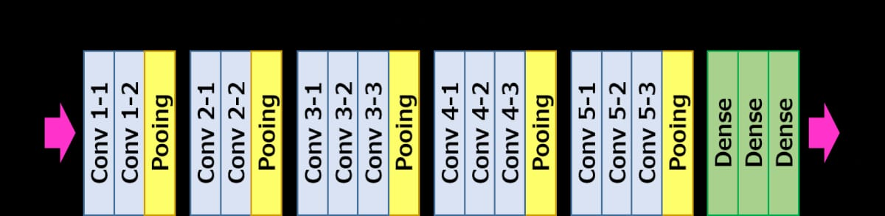
STRUCTURE OF VGG16

Slide 18
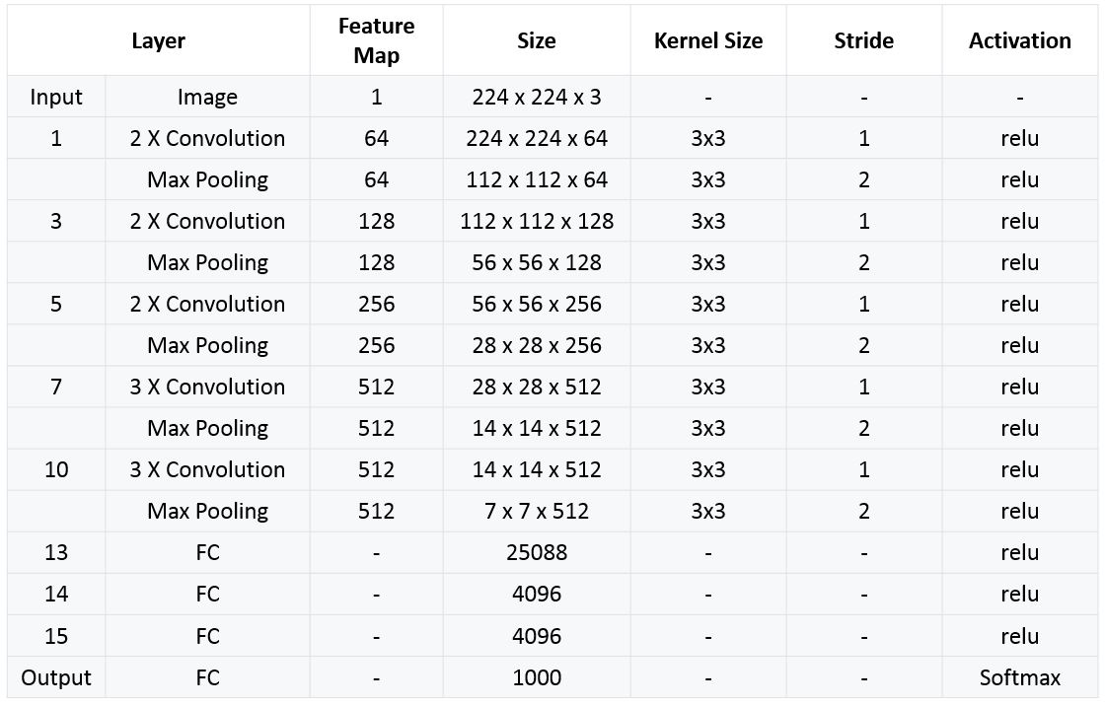
DEEP INSIDE THE ARCHITECTURE OF VGG16

Slide 19
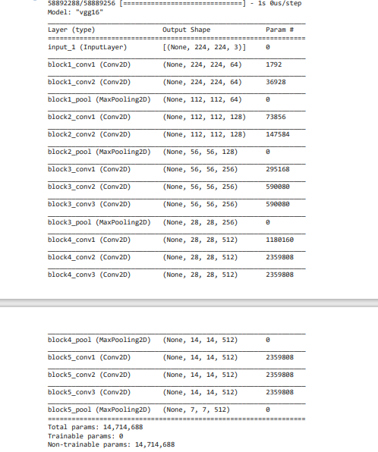
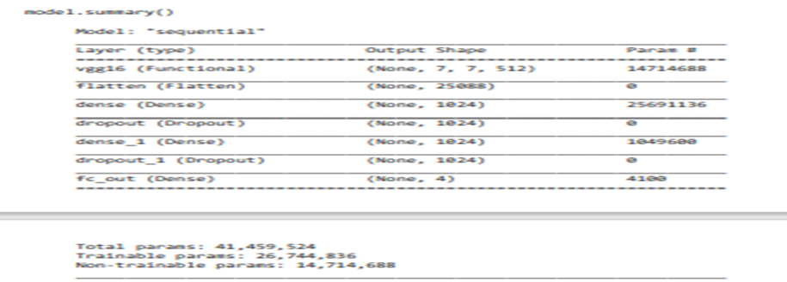
VGG 16 MODEL PROJECT

Slide 20
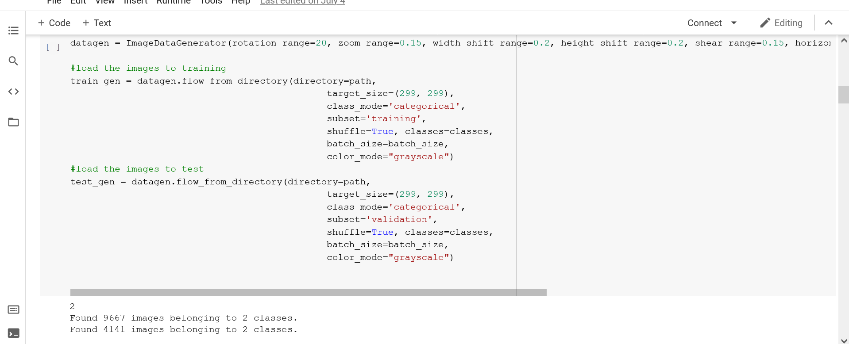
Snapshots of code and output
Basic CNN Architecture:

Slide 21
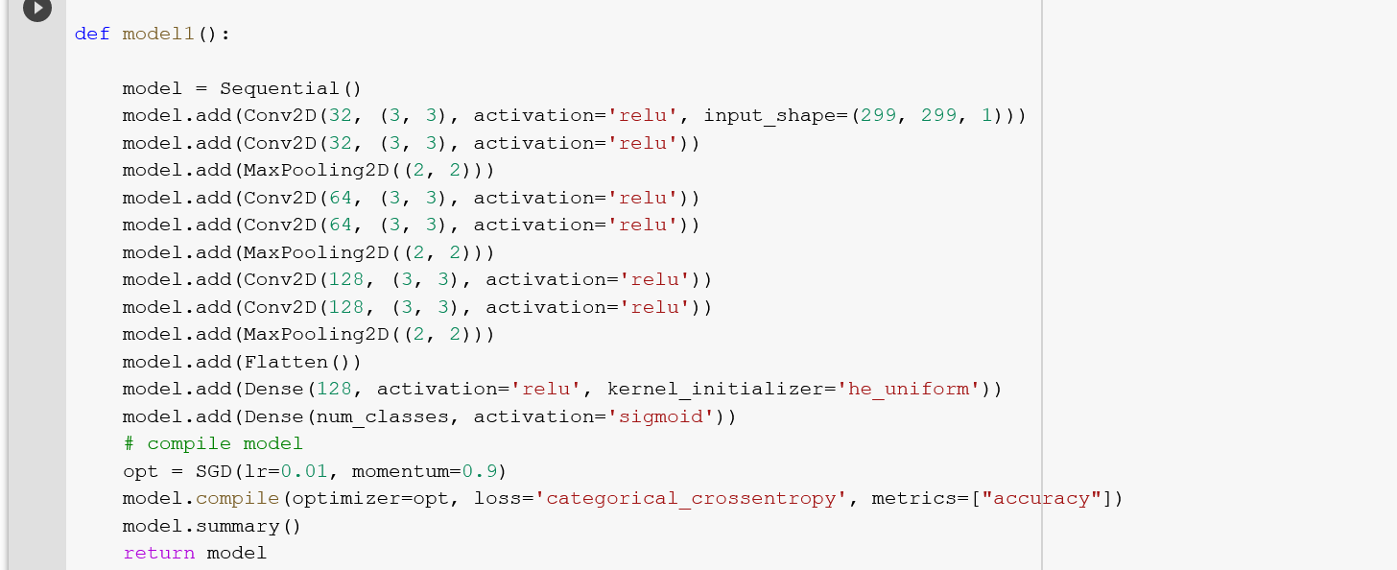
Snapshots of code and output
Basic CNN Architecture:

Slide 22
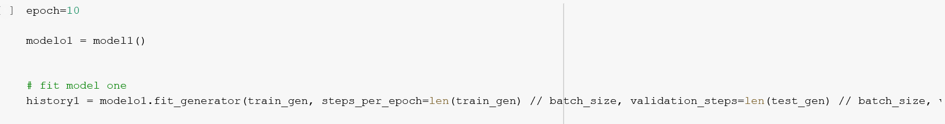
Snapshots of code and output
Basic CNN Architecture:

Slide 23
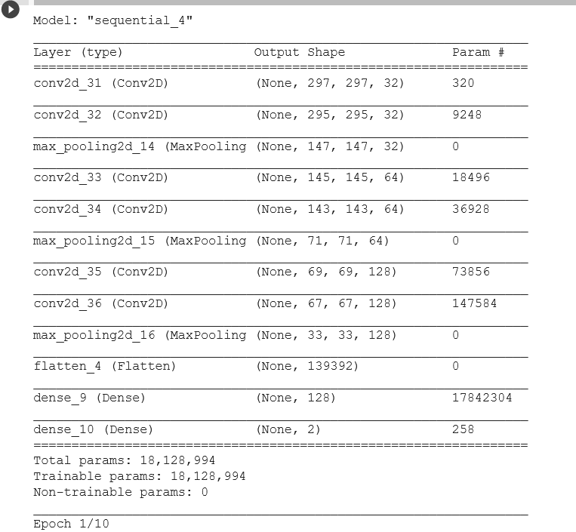
Snapshots of code and output
Basic CNN Architecture:

Slide 24
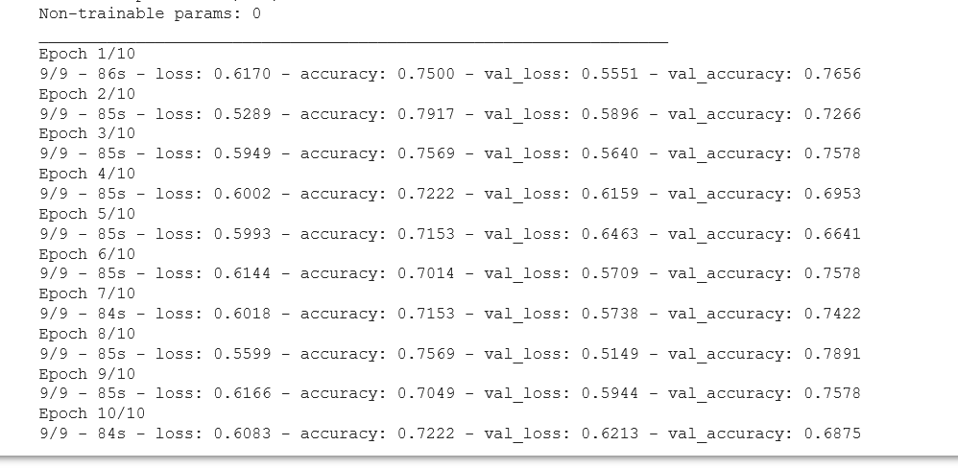
Snapshots of code and output
Basic CNN Architecture:

Slide 25
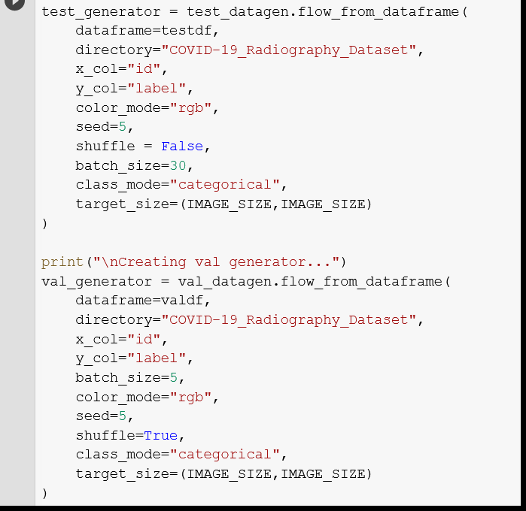
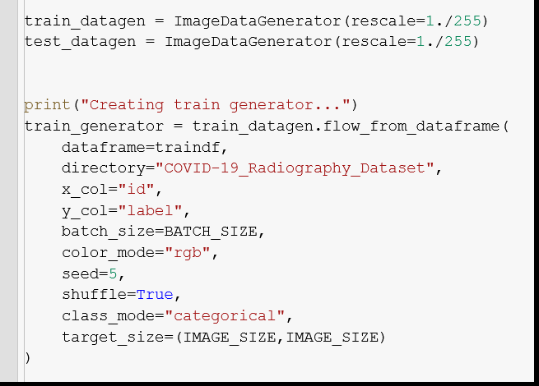
Snapshots of code and output
VGG 16 Architecture:

Slide 26
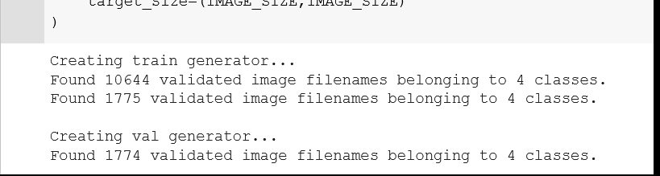
Snapshots of code and output
VGG 16 Architecture:

Slide 27
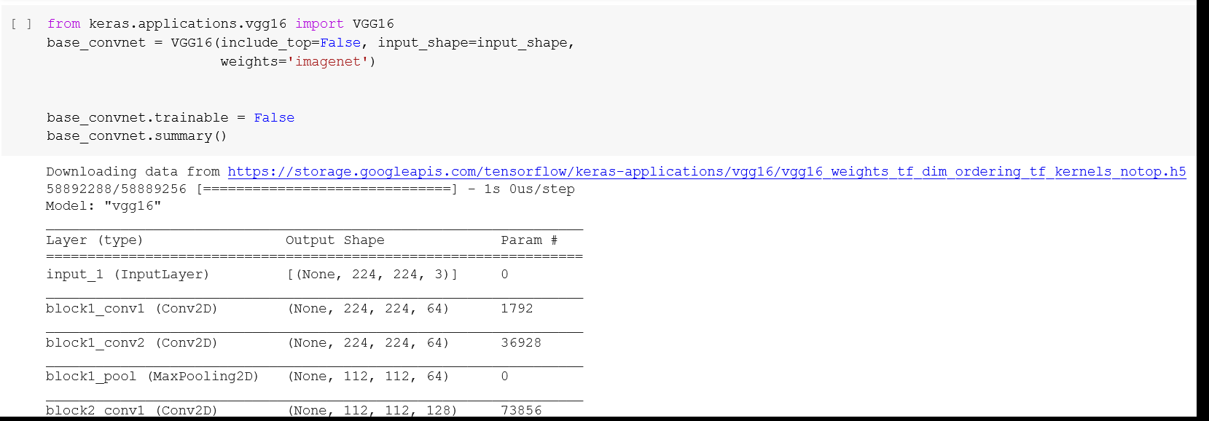
Snapshots of code and output
VGG 16 Architecture:

Slide 28
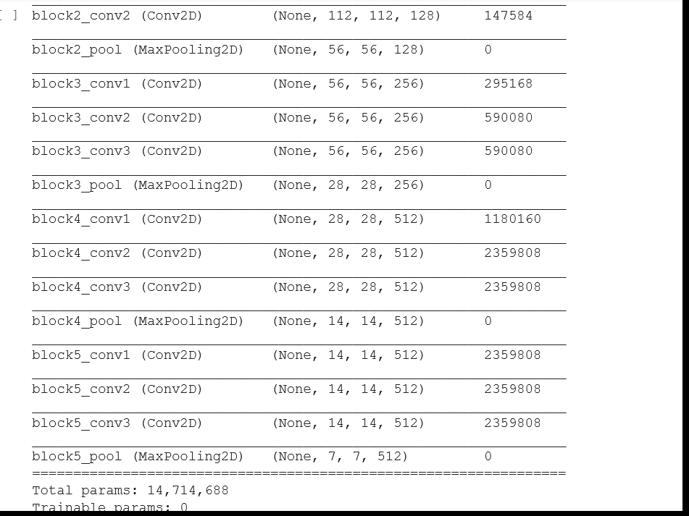
Snapshots of code and output
VGG 16 Architecture:

Slide 29
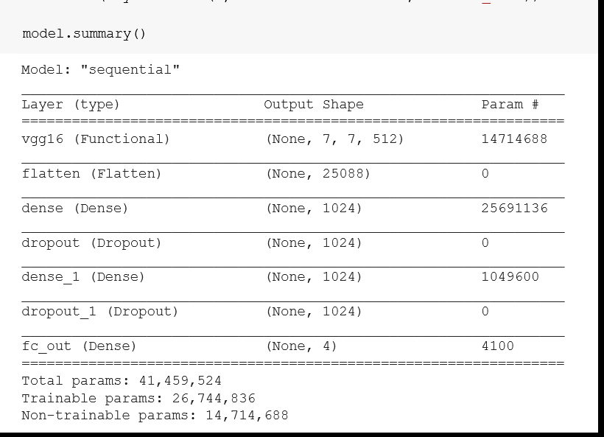
Snapshots of code and output
VGG 16 Architecture:

Slide 30
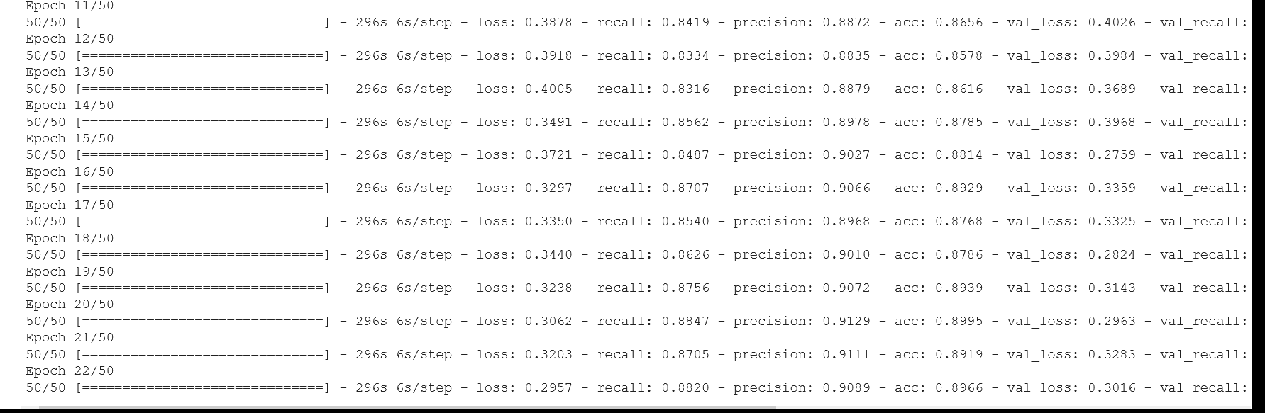
Snapshots of code and output
VGG 16 Architecture:

Slide 31
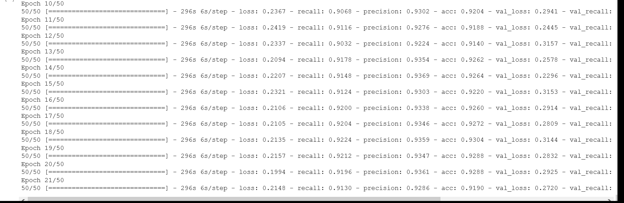
Snapshots of code and output
VGG 16 Architecture:

Slide 32
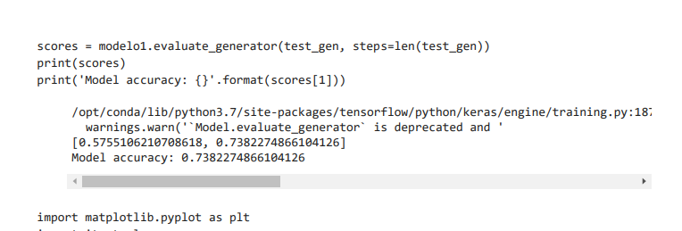
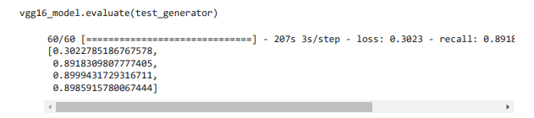
EVALUATION/ASSESSMENT
Evaluation provides a systematic method to study a program, practice, intervention, or initiative to understand how well it achieves its goals.
CNN | VGG16

Slide 33
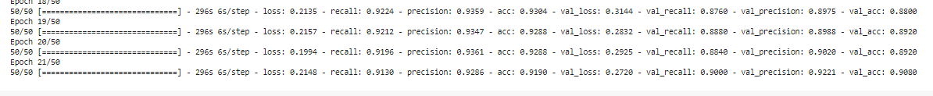
ACCURACY OF VGG16

Slide 34
Links to the codes
Basic CNN Code:
https://drive.google.com/file/d/1Ax9f_zKCYSFXq-MoQDDZGpRMz2UuODgM/view?usp=sharing
VGG16 Architecture Code:
https://drive.google.com/file/d/1mj5OxqlxyuAnsAUu-X1_ngHFD5gWOs0d/view?usp=sharing
Github Link:
https://github.com/abhinavrks012/Detection-of-COVID-19-using-Radiography-images.git

Slide 35
Future Scope
In this project, we have used a BASIC CNN MODEL and VGG16 MODEL for training our dataset.
It is simple to understand and explainable. Using these models, we have got 75% accuracy in CNN and 90% accuracy in VGG16.
We have taken limited dataset for our project. Here, when we can take huge dataset then at the same time these models -BASIC CNN and VGG16 will give us a better accuracy.
In coming future, if we add more data , we will get a better accuracy. We can use different pre-trained models like ResNet , DenseNet and MobileNet for getting better accuracy and these models take lesser memory, faster inference time, and allows deeper networks to be trained easily.
DenseNet, MobileNet, more data and tuning will definitely give us a better accuracy.

Slide 36

Thank You

